Slide 1
CAREER PATH STUDENT

Slide 2

College Degree
Bsc Cyber Security
Bsc Computer Science
Bsc Computer Engineering
Bsc Networking
Any IT related field
Mathematics

Slide 3

Self Study
Basics of Networking
Basics of Computer Security
Basics of Web development

Slide 4
Self Study
IP & MAC addresses
Switches, routers & hubs
Ethernet
HTTP, HTTPS, TLS/SSL
TCP/IP
OSI Model
Domain Name System
DHCP
Ports
Malware
Antivirus, firewalls, IDS, IPS, encryption, biometrics
Hacking methodology
Phishing, sql injection, brute force attacks, ransomware etc
Social media & privacy issues
VPNs,Tor & Anonymizers
HTML, CSS
How web servers work
Basics of databases

Slide 5
Self Study Materials
Comptia security+ certification
Comptia network+ certification
CCNA certification
Online courses for basics of cyber security and web development

Slide 6
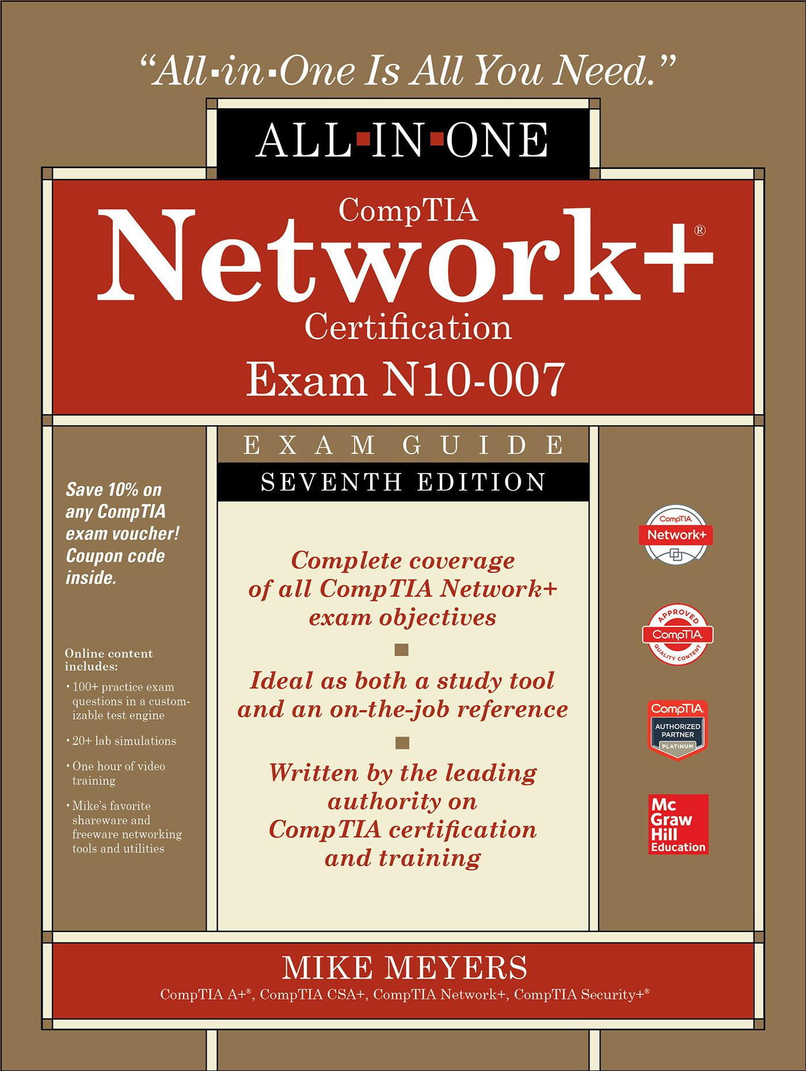

Self Study Materials
CBT Nuggets training videos

Slide 7
Work Experience
Internships
Decide what field you want to go for
Setup labs at home e.g buy cheap router, computer, cables, use hacking software

Slide 8
Work Experience
Graduate
Start applying for jobs - security analyst
Gain certifications for specialization i.e CEH, CFA, CISSP
Grow your career
Master’s degree?

Slide 9

Huge Demand

Slide 10

Learning never stops

